Slide 1
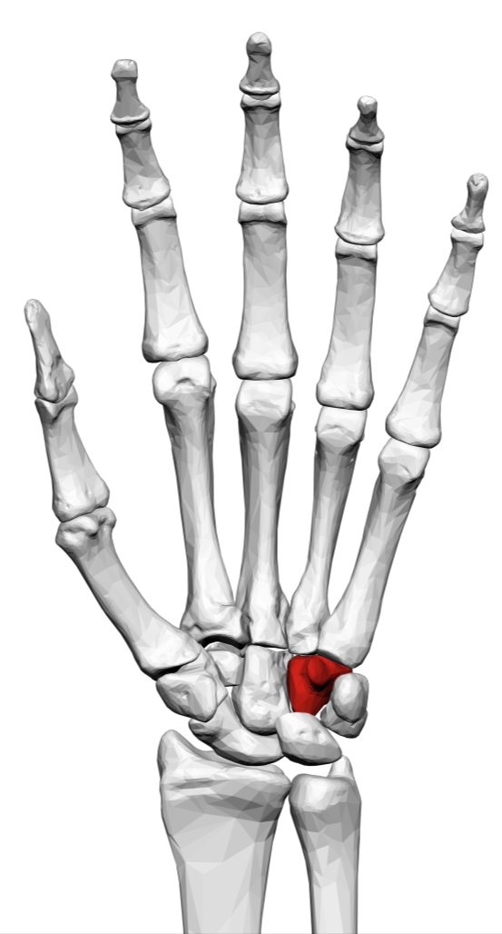
Hand and finger injuries
15 min safety stand-down for your team;
It is designed to get people thinking about hand injuries and the hazards we face.
The slides are to generate thoughts/ideas rather than to be presented

Slide 2
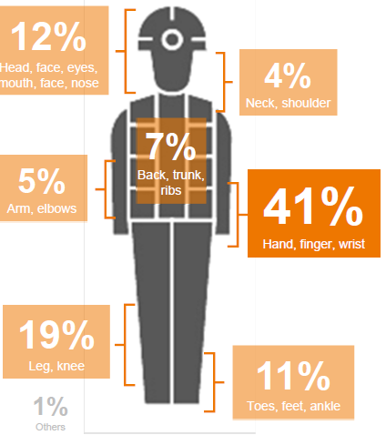
Hand Injury Numbers - 2018
All Injuries for Rio Tinto (on left)
41% Hand Injuries
High percentage of laceration, fracture, crush

Slide 3
Borates Hand Injuries in 2019
Wilmington – Hand hit by hammer
Boron – Top finger cut while opening a barrel
Boron – Stitches required in finger as a result of injury sustained while working on the pan conveyor
Boron – Contractor crushed hand between boom lift and plant structure

Slide 6
1. What hand injury hazards are in our work area?
Get the team to brainstorm the possible hand injury hazards in the workplace
Here are some common ones
Some common hand hazards are as follows:
• Sharp objects
• Hand and power tools
• Hot objects
• Pinch points (What causes the pinch, energy source and line of fire)
• Chemicals
• Energy Sources / Line of fire
• Moving equipment
• Machinery
Many hand injuries involve your feet. Workers, who lose their balance, slip on surfaces or trip over hazards can sustain wrist and hand injuries.
The contributing factor could be Poor Housekeeping/Body Stance

Slide 7
2. What types of hand injuries could happen in our area?
Lacerations
Cuts (ranging from minor to major if tendons or nerves are severed)
Fractures
Amputations
Strains and Sprains (excessive force)
Excessive repetitive motion
Awkward posture
Contact with surface conditions
Skin irritation (exposure to hazardous/irritating substances)
Burns (electricity, chemicals, hot substances)
Punctures (tools and other sharp objects)
Ask the team what type of injuries could be caused in your area
Here are some common ones

Slide 8
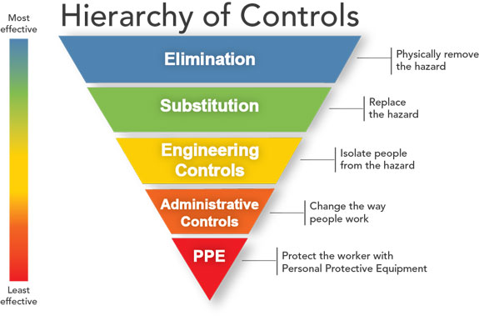
3. Are our hand injury hazards controlled?
Are all the hand hazards in the work area controlled?
Remember the hierarchy of controls
Follow up on any unresolved hazards
Don’t forget to submit an innovation if you develop new controls
Provide feedback to your superintendent

Slide 9
For completion;
Complete safety stand down talk on hand injuries with your crews (as soon as practical)
Your field interactions (Wednesday and Thursday) to focus on hand injuries
Report completion of stand down on the Teams App.
Provide insights from the stand-down / field discussions on the Teams App

